Slide 1
EDUC2323 Computer Programming as a Tool for Learning

Slide 2
Plan
Introducing sprite cloning
  And elements of object oriented programming
A final challenge – analysing Whack-a-mole
And then… Individual work on projects

Slide 3
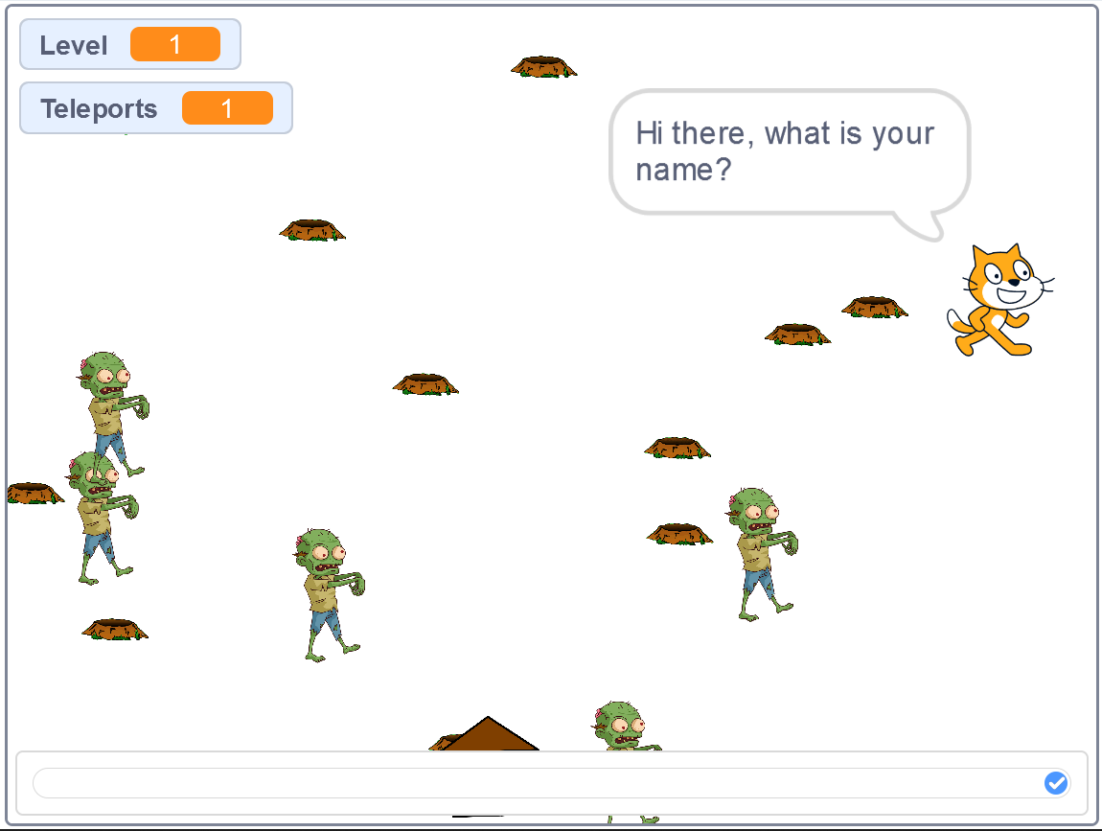

Slide 4
Cloning sprites
Offers us a simple introduction to the world of Object Orientated Programming (OOP):
  Class: collection of sprite templates (e.g. cat, balloon, ball)
  Object: (a particular sprite I’ve set up in a particular way, e.g. certain looks, scripts etc – called ‘properties’) – also called a ‘parent’ sprite
  Instance: each individual clone of my sprite object –also called ‘child’ sprites
Clones ‘inherit’ the scripts, costumes, sounds and properties of the parent sprite, but can be modified separately once created
Cloning allows us to make copies of sprites while a program is running.
  A very powerful technique for projects where you need lots of the same type of object (stars, bricks, planets, bubbles) , all behaving in the same way

Slide 5
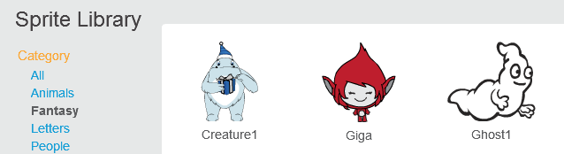
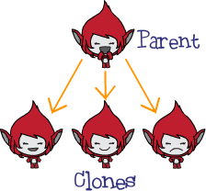
Class
Object
Instances

Slide 6
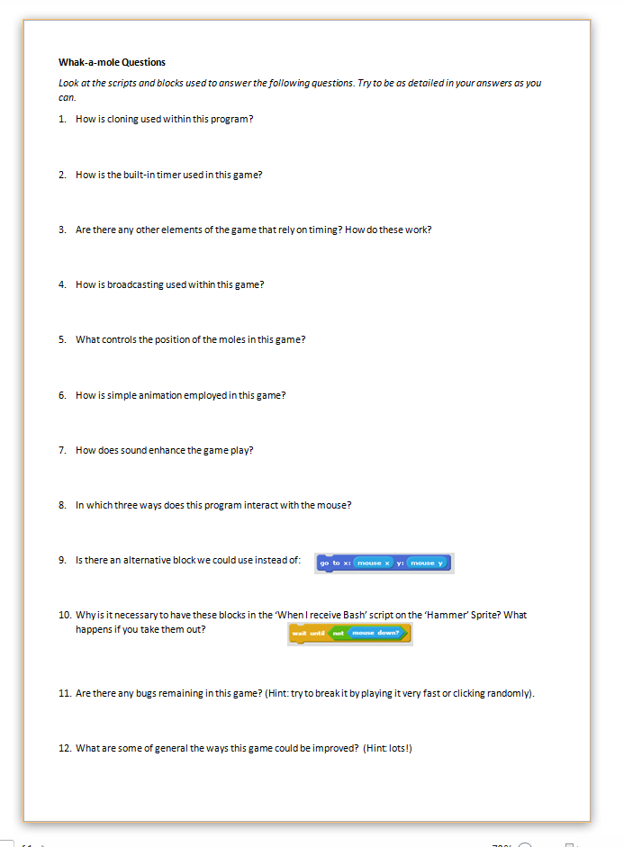
A final challenge…
Check out this simple version of Whack-a-mole:
  https://scratch.mit.edu/projects/143699447/
Grab a hard copy sheet of questions (or an electronic copy from Blackboard.
Work through these questions in as much detail as you can, checking the sprites, scripts and costumes in the project carefully.
Answering these questions accurately and in detail will confirm your understanding of lots of Scratch concepts and techniques from recent sessions…

